Slide 1

CS 7641 Project Proposal
Machine Learning for Auto-trader
Group 16
Dan Nguyen, Jiaying Li, Yilong Tang, Alan H Yu

Slide 2


Introduction/Problem Definitions
Stock market investment:
Understand metrics, indications
Updated with financial/political/economical events
⇒ Financial decisions
Machine learning approach:
Efficient and Robust analysis of large data
Recognize current patterns
Make predictions in advance
Better fit and tune parameters
Source: [7] Symington, S. (2019, March 12). Stock market Today: Stitch fix soars on Stellar Earnings. The Motley Fool.

Slide 3
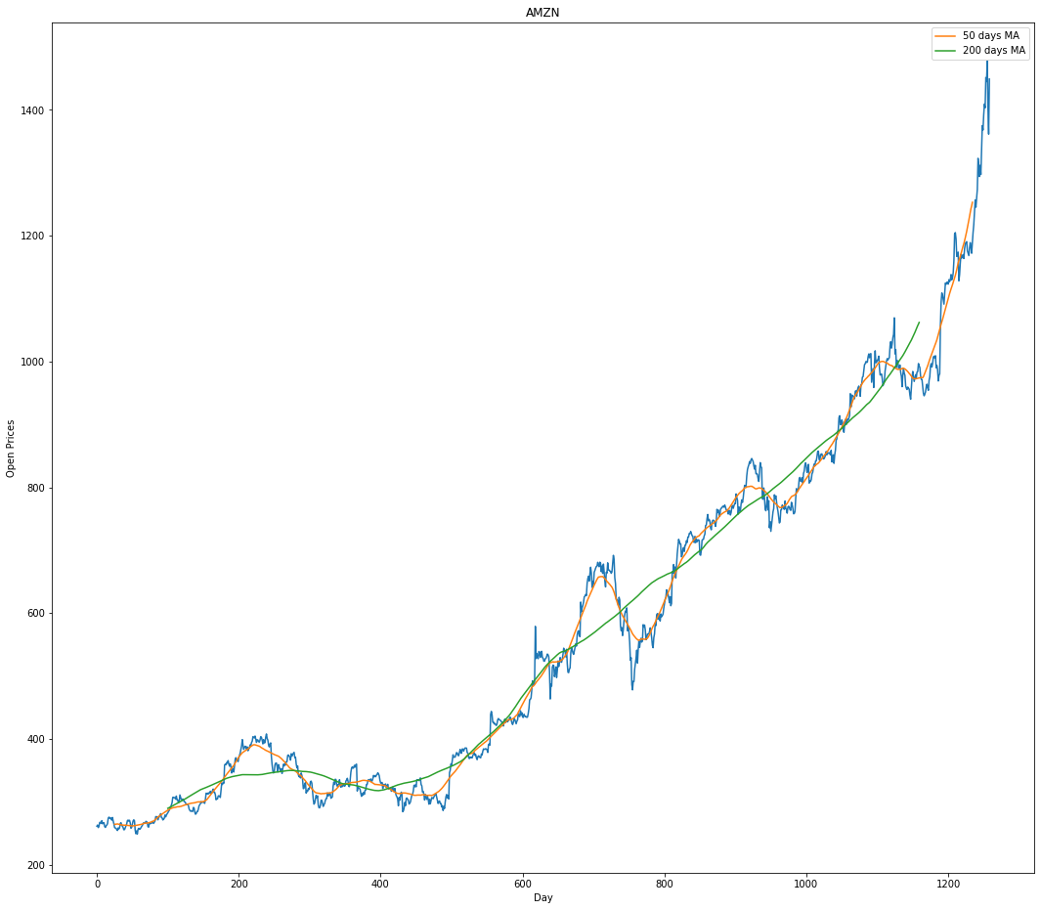
Datasets
Numerical Data
Kaggle
5 Years records of S&P 500 companies stock data
Use “Price change” to measure movement of stock price
Movement of AMZN stock, average applied. Generated by Group 16

Slide 4
Methods
Unsupervised Machine Learning
KMeans
Normalized dataset to a standardized version
Used PCA to reduce features in dataset to 2 components
Cluster different stocks, calculate percentage change in price each day
Supervised Machine Learning
LSTM
Assume opening and ending stock price depends on prices on previous day
Perform better in long sequences, suitable for this dataset

Slide 5
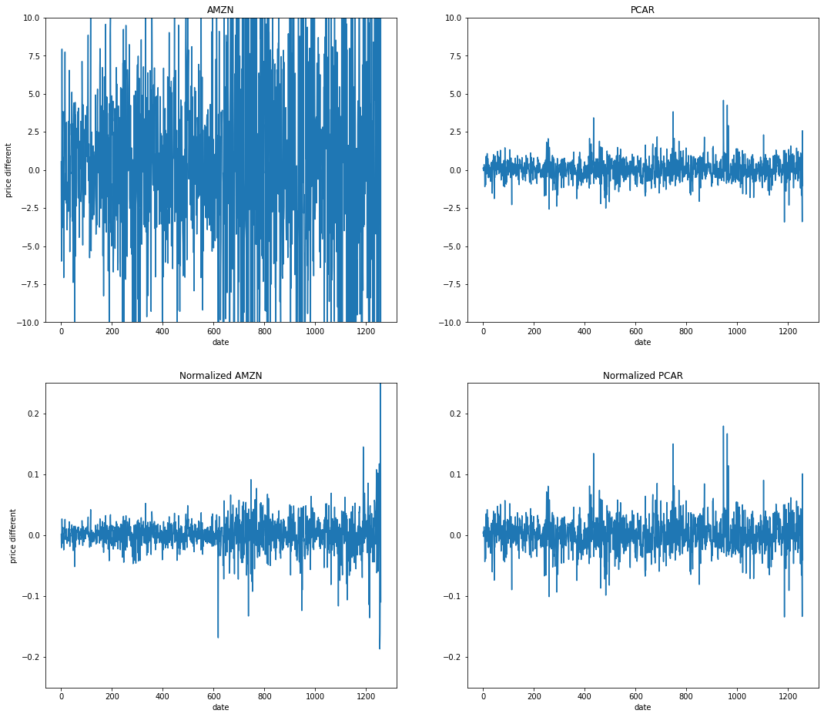
Results (Data Processing)
Normalization
PCA
Selected top 2 features
Compared models before and after applying PCA with Silhouette score
→ PCA significantly improved our model

Slide 6
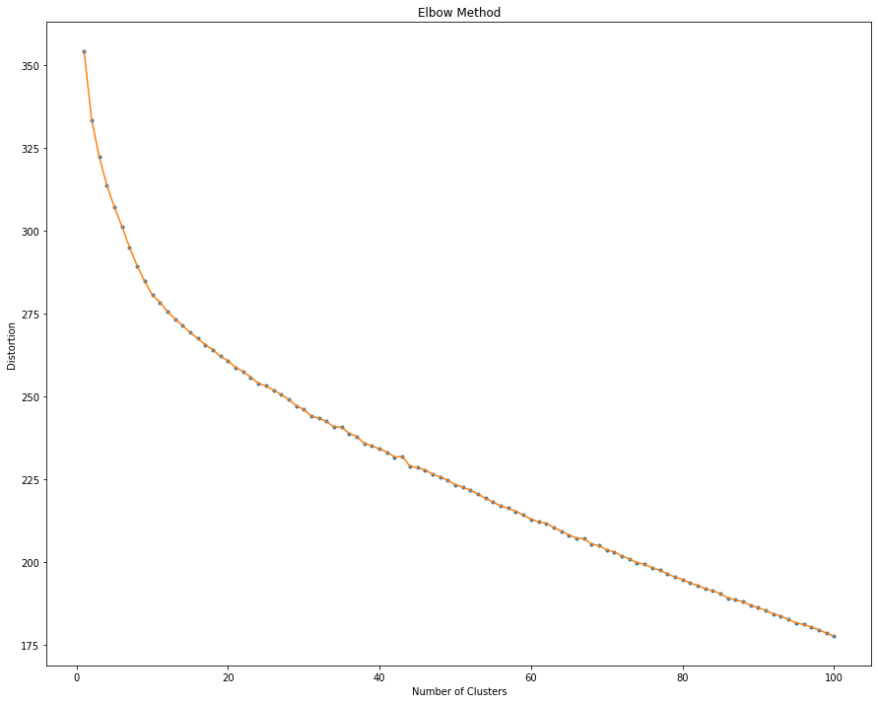
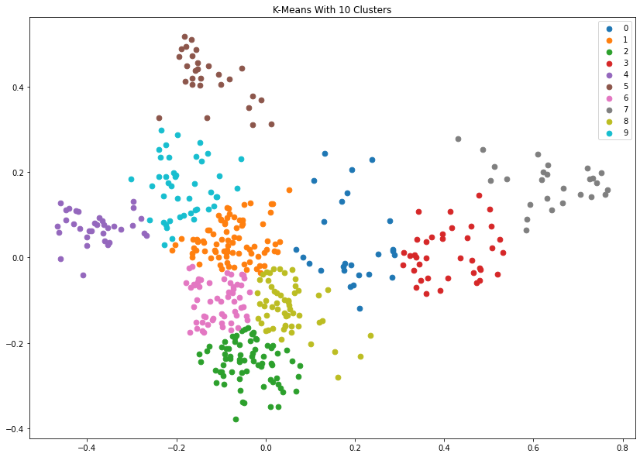
Results (KMeans)
Elbow’s method: choose K value
Clustering Result

Slide 7
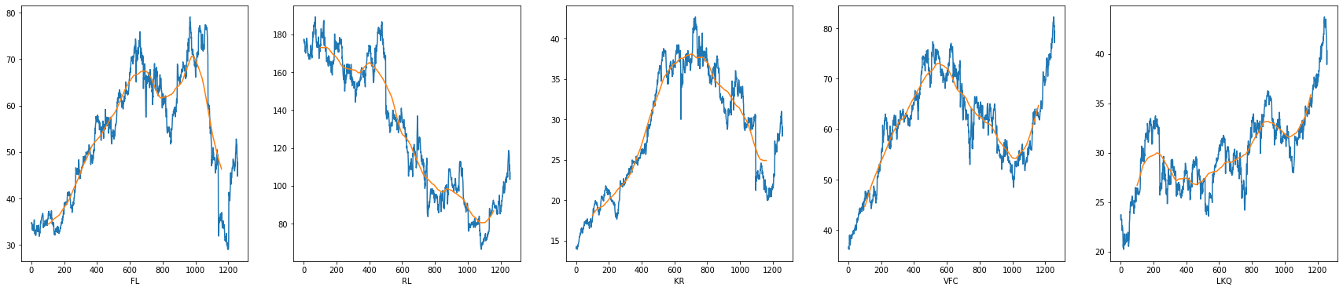
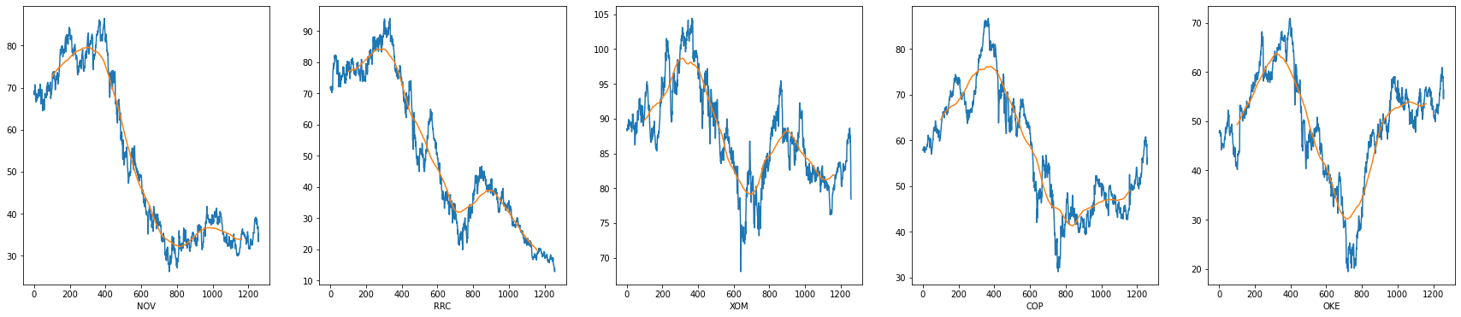
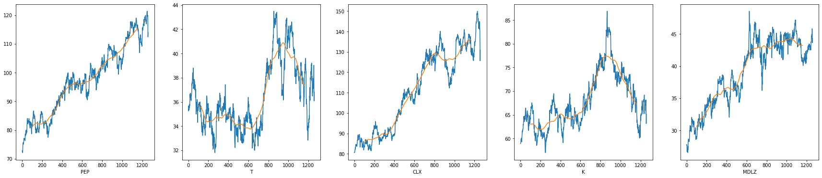
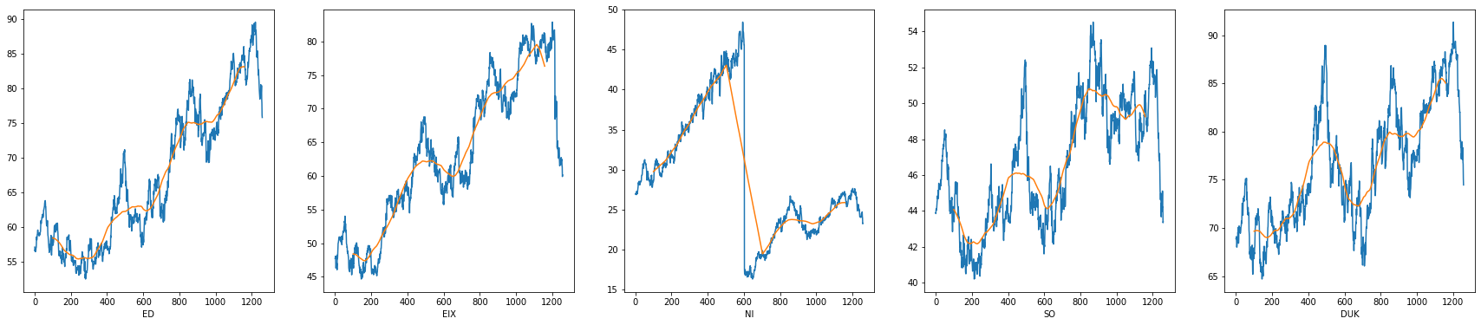
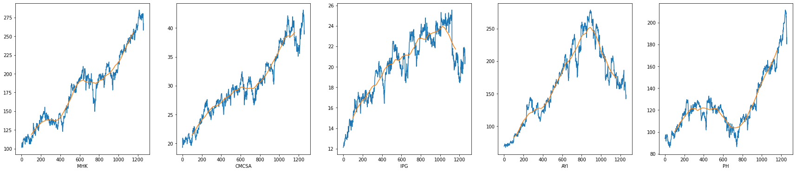
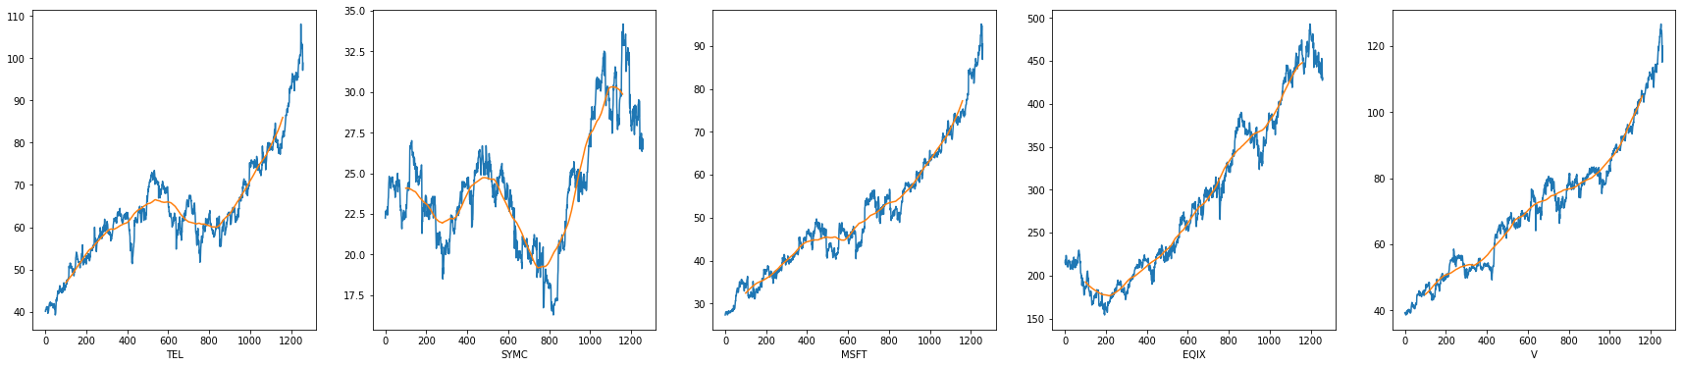
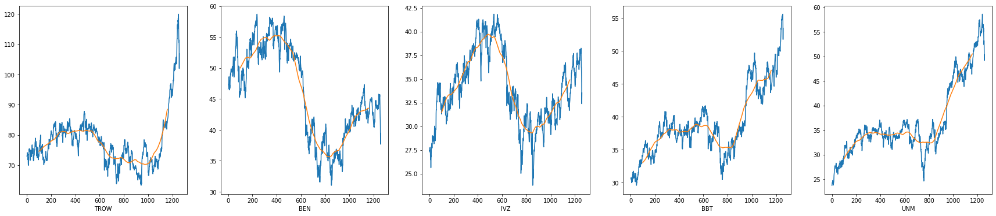
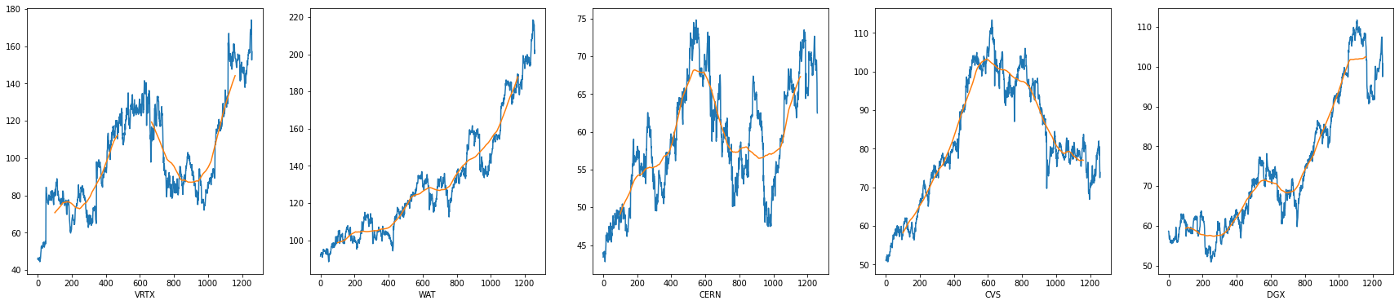
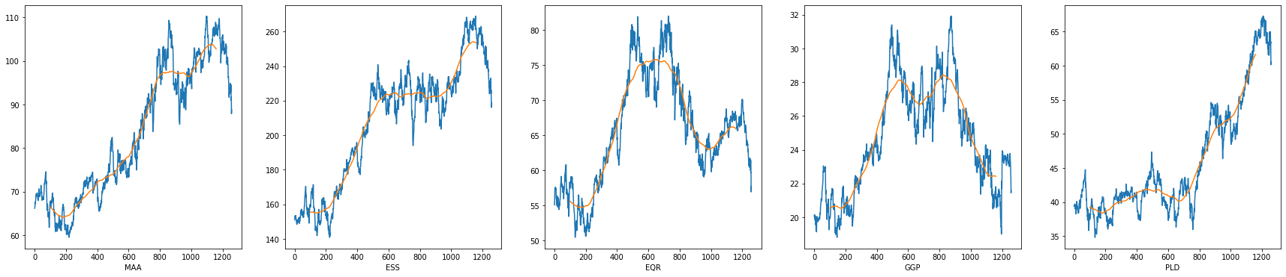
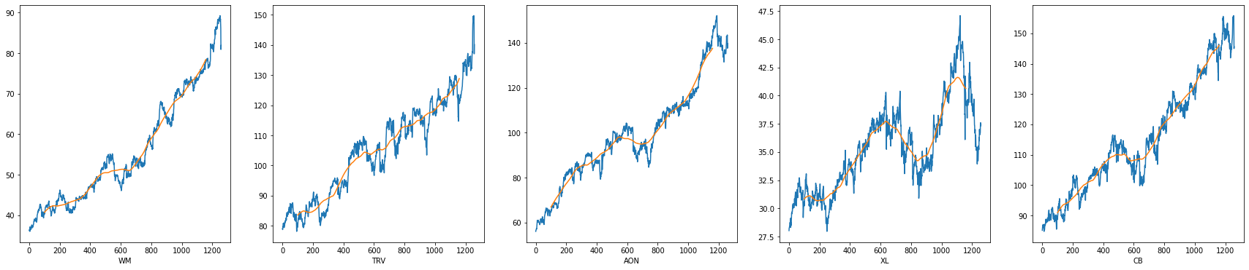
Results (KMeans)

Slide 8
Results (KMeans)
 | Without PCA | With PCA
Silhouette Score | 0.05867 | 0.39538

Slide 9
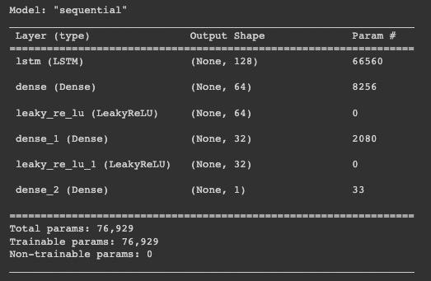
Result (LSTM)
Notes:
Sequential model

Slide 10
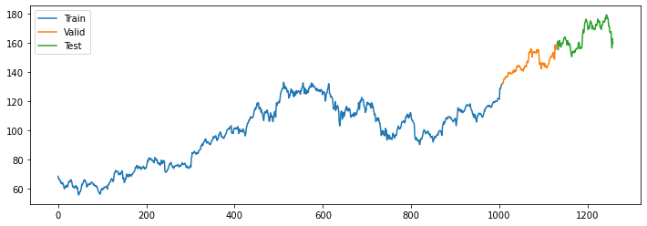
Results (LSTM)
Data splitting
Notes:
Time series data, the future data is dependent with the past data.
When doing data splitting, we couldn’t use cross validation or randomly select data points.
We split the dataset into a training set, validation set and testing set. As shown in the figure below, there are 80% training set, 10% validation set and 10% testing set.

Slide 11
Results (LSTM)
Learning Rate | 1 Day Shift | 2 Days Shift | 3 Days Shift | 4 Days Shift | 5 Days Shift | 6 Days Shift | 7 Days Shift
0.0001 | 11.2199 | 11.564 | 13.732 | 13.992 | 13.078 | 12.562 | 13.892
0.0005 | 5.19 | 9.937 | 12.541 | 11.313 | 11.088 | 11.273 | 10.175
0.001 | 7.003 | 11.432 | 11.336 | 12.569 | 11.492 | 10.974 | 10.104
0.005 | 6.131 | 13.6 | 15.418 | 13.204 | 14.106 | 12.983 | 12.068
0.01 | 9.693 | 15.169 | 17.995 | 13.721 | 16.964 | 16.067 | 15.644
Notes:
There are three parameters we need to tune: learning rate, epochs and day shift.
A table of learning rate and day shift with different values are shown as the table below
From the table, we can find that day shift = 1 will always lead to minimum RMSE value, which means that the price of stock will be more dependent on the previous day. Overall, we choose learning rate = 0.0005, day shift = 1, and epoch = 50 as our parameters.

Slide 12
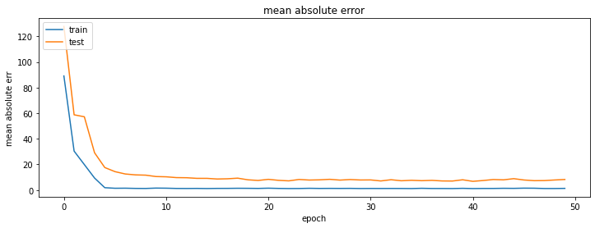
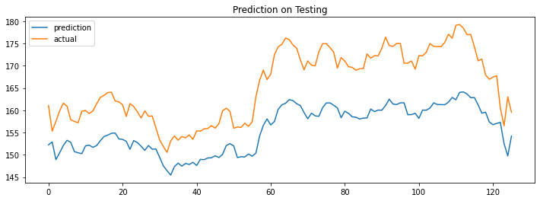
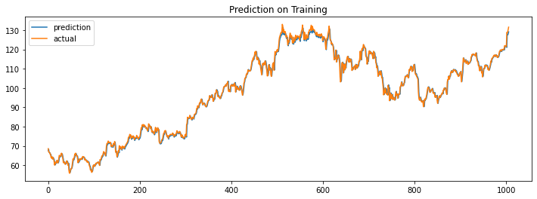
Results (LSTM)
lr = 5e-4
epoch = 50
day shift = 1
Notes:
Evaluate the model using AAPL stock
Examine the loss by plotting the mean absolute error
The plots above show an example for stock price tendency prediction on the training set and testing set respectively. The RMSE on the testing set is 4.711.

Slide 13
References
[1] Khaidem, L., Saha, S., & Dey, S. R. (2016, April). Predicting the direction of stock market prices using random forest.
[2] Zolotareva, E. (1970, January). Aiding long-term investment decisions with XGBoost machine learning model.
[3] Yahoo! Finance. Yahoo! https://finance.yahoo.com/, 2022.
[4] Alpha Vantage. Alpha Vantage Inc. https://www.alphavantage.co/, 2022.
[5] Obthong, M., Tantisantiwong, N., Jeamwatthanachai, W., & Wills, G. (2020). A survey on machine learning for stock price prediction: algorithms and techniques.
[6] Ding, X., Zhang, Y., Liu, T., & Duan, J. (2015, June). Deep learning for event-driven stock prediction. In Twenty-fourth international joint conference on artificial intelligence.
[7] Symington, S. (2019, March 12). Stock market Today: Stitch fix soars on Stellar Earnings. The Motley Fool.
[8] Nirek, R. (2020, June 23). Gaussian Mixture Models(GMM). Medium. https://towardsdatascience.com/gaussian-mixture-models-gmm-6e95cbc38e6e
‌

